Slide 1
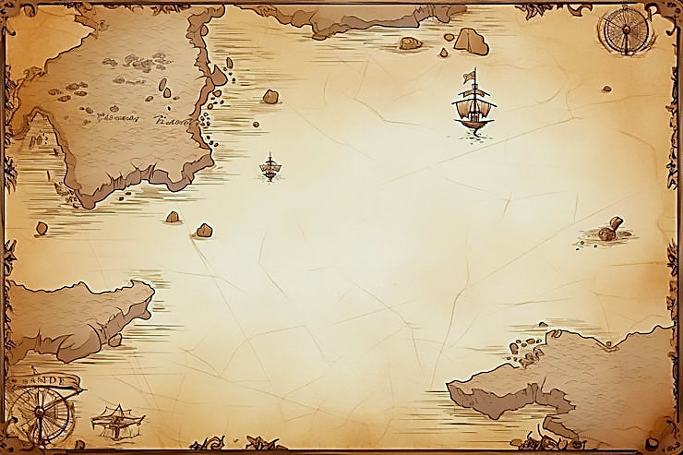
FUNDAMENTALS I:
WORKING & THINKING LIKE AN ECONOMIST

Slide 2

A Pirate’s Guide to the Economic Way of Thinking!

Slide 3
What is Economics?
A way of thinking about the world.
An approach to problem solving that is based in the study of individual human choice and action.
Why do people choose?

Slide 4
Scarcity
The reality that we have unlimited wants but limited availability.
Notes:
The reality that we have unlimited wants but limited availability.
All resources are scarce! We forced to make choices.
The use of scarce resources to produce a good or service is always costly.
Using resources one way means we can’t use them in another way.
Understanding why we make the choices we do is what economics is for.

Slide 5
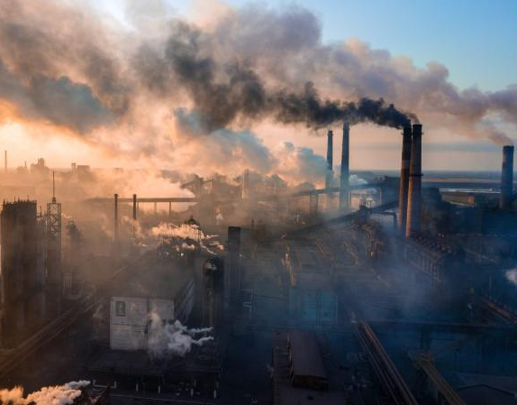
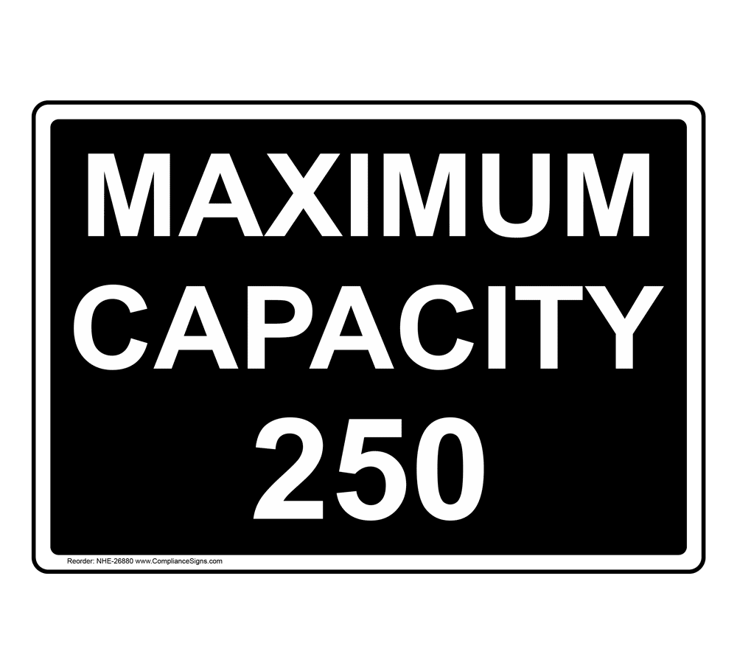
AIR

Slide 6
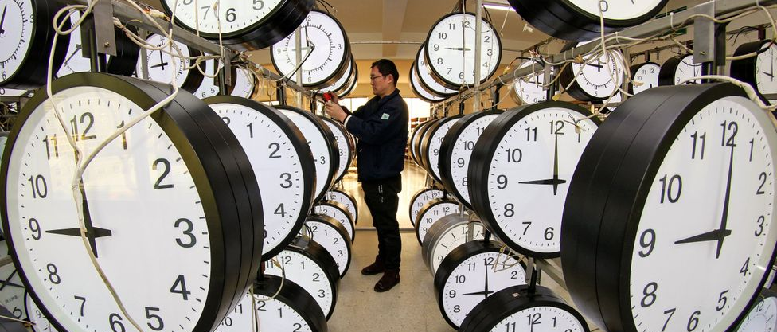

TIME

Slide 7


Slide 8


Scarcity is Relative
“The Diamond Water Paradox”
Increases in price mean a good has become relatively more scarce.
Notes:
Water vs. drinking water
Energy vs. wind energy
Cars vs. Corvettes
Food vs. Tomatoes

Slide 9
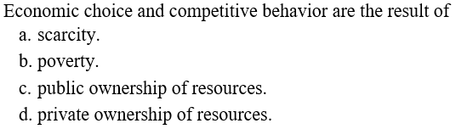
Notes:
If scarcity were eliminated all goods would be free, everyone would have what they want at no cost, and no one would have to make choices. Scarcity persists because economic wants exceed available productive resources.

Slide 10
Scarcity
≠
Poverty
Notes:
Scarcity is an objective concept that describes a factual situation in which the limited nature of our resources keeps us from being able to completely fulfill our desires for goods and services. Poverty is a subjective concept that refers to a personal opinion of whether someone meets an arbitrary level of income.

Slide 11
Economics as a Positive Science
Positive Statements
Statements about how things are.
Normative Statements
Statements about how things ought to be.

Slide 12
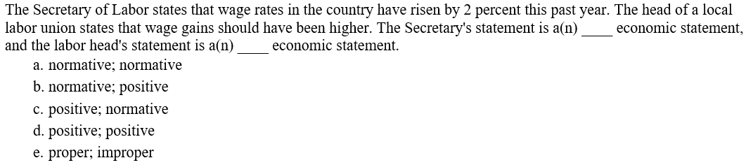

Slide 13
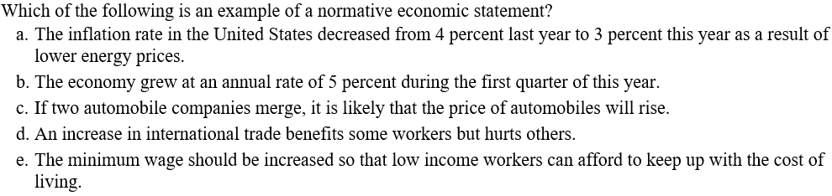

Slide 14
Value is SUBJECTIVE
Notes:
The value individuals place in a given choice or action is subjective to them.
Whether or not they ought to have these values is irrelevant when doing standard economic analysis.

Slide 15
Assumptions of Human Choice/Action
Individuals are rational (economizing).
Individuals are self-interested.
Individuals make choices at the margin.
Individuals are well-informed?
Notes:
Rational:
The manner in which we behave to achieve our objective.
Economizing: gain a specific benefit at the least possible cost.
Utility: basis for the evaluation of alternatives, the benefit they expect to receive from a choice.
Self-Interest:
Desired ends are subjective.
People do things that interest them.
Actions are taken to achieve those desired ends.
The Invisible Hand of the marketplace guides the self-interest of individuals into social well-being.
Marginal Choice:
The process of making choices in increments.
Looking at the benefits and costs of doing a little bit more, or less, of an activity.
Should I produce one more unit of output?
Should I study one more hour for the exam?

Slide 16
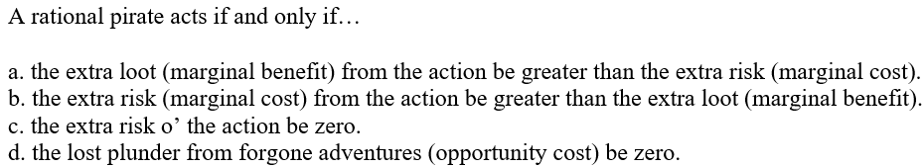

Slide 17
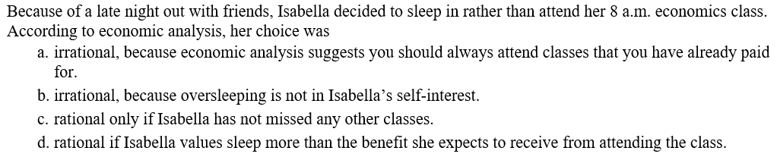

Slide 18
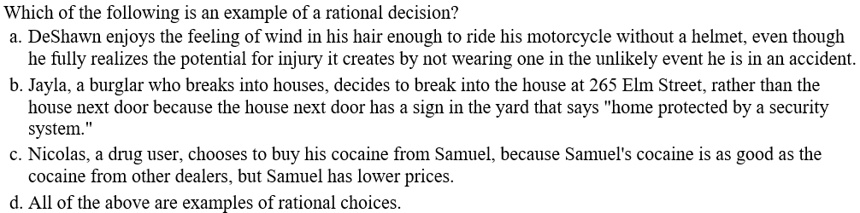

Slide 19
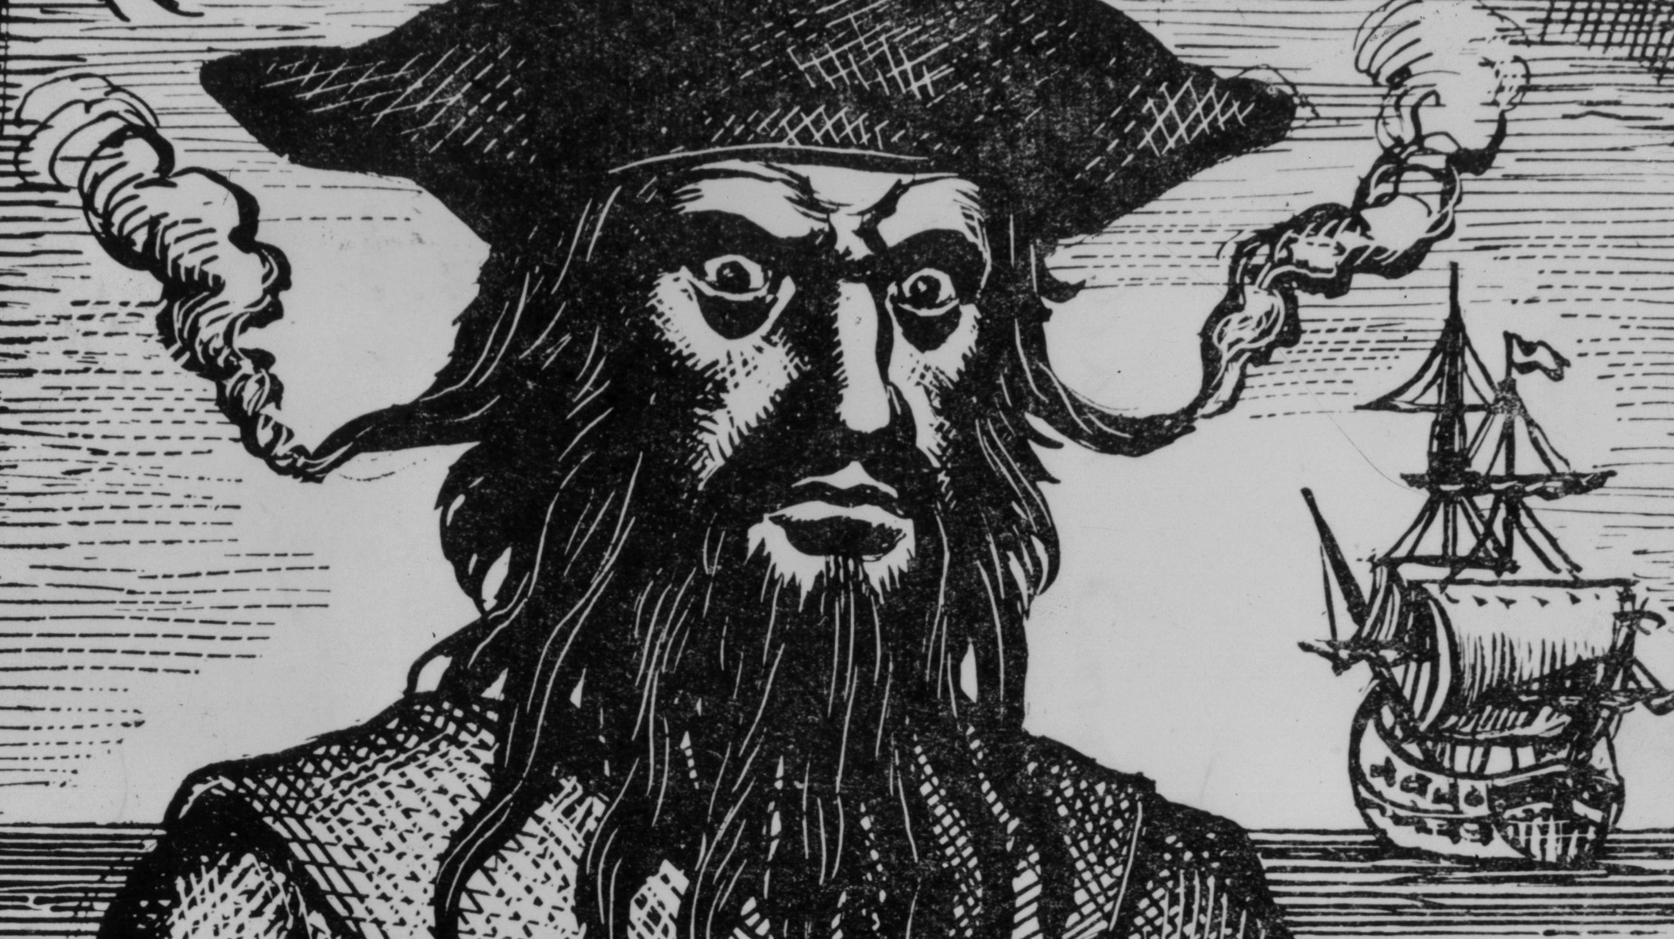

Slide 20
Marrrrrrrrrrginal Analysis

Slide 21
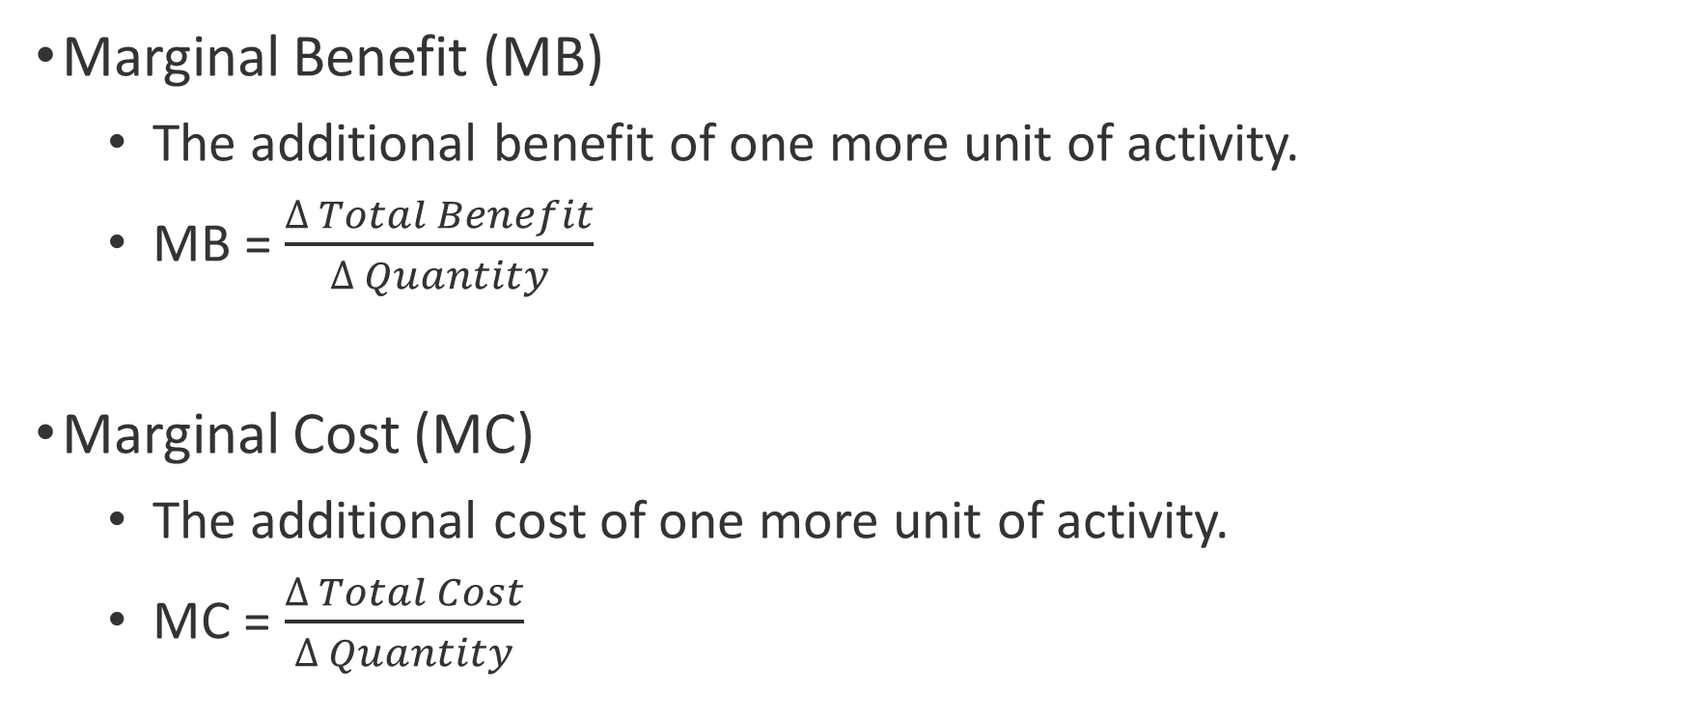
Marginal Analysis
Marginal Benefit (MB)
The additional benefit of one more unit of activity.
MB = $\frac{∆ Total Benefit}{∆ Quantity}$
Marginal Cost (MC)
The additional cost of one more unit of activity.
MC = $\frac{∆ Total Cost}{∆ Quantity}$

Slide 22
Marginal Analysis: Sailing for Treasure
Days Sailing (per week) | Total Benefit | Marginal Benefit | Total Cost | Marginal Cost
1 | $1,000 |  | $100
2 | 1,800 |  | 250
3 | 2,500 |  | 450
4 | 3,000 |  | 700
5 | 3,300 |  | 1,000
6 | 3,500 |  | 1,300
7 | 3,600 |  | 1,750

Slide 23
The Rule of Rational Life! MB = MC

Slide 24
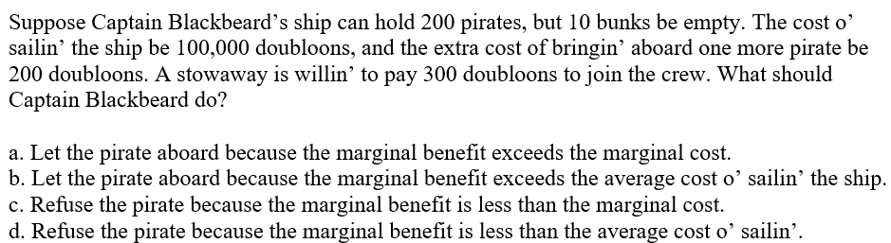

Slide 25
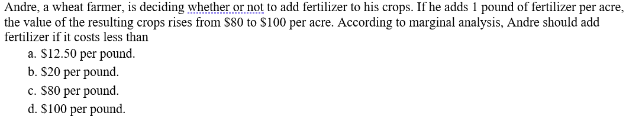

Slide 26
Opportunity Cost

Slide 27
Opportunity Costs
Arguably the most powerful concept of economics!
The value of the next best alternative forgone from making a choice.
What you give up in order to obtain something else.
Notes:
A good application of the UNSEEN.

Slide 28
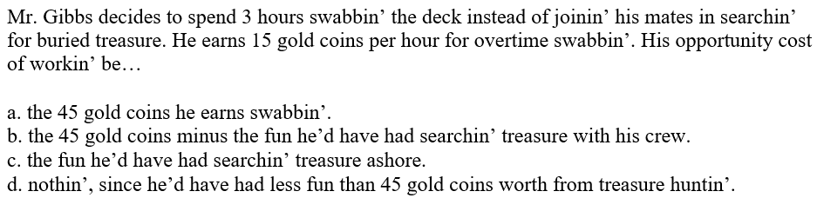

Slide 29
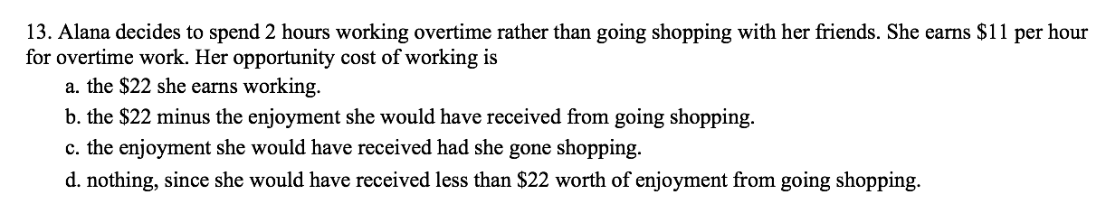

Slide 30
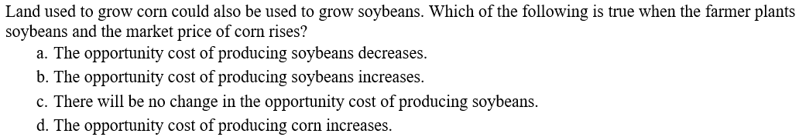

Slide 31
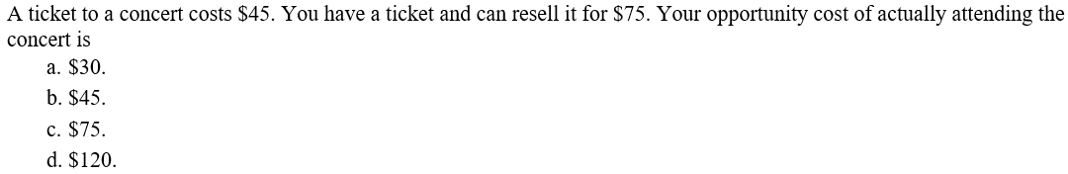

Slide 32
Opportunity Costs
Opportunity costs are NOT just monetary costs!
Costs are subjective to the individual (e.g., time or psychic value). A great example of the UNSEEN of economics.
NOTHING is really free!
Notes:
A good application of the UNSEEN.

Slide 33
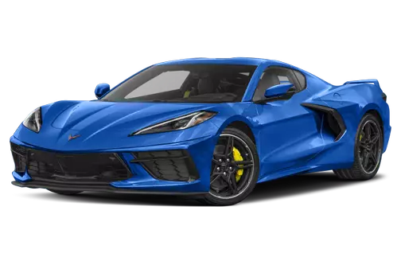
Free Car?
Someone gives you a free car valued at $200,000. If you keep it, your opportunity cost may be selling it and making $200,000.

Slide 34
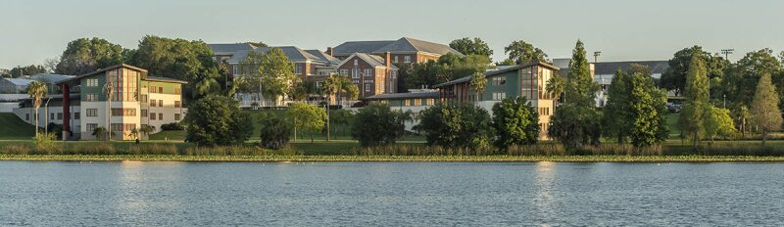
Opportunity Cost of Attending Florida Southern?
Not just your tuition!
A job and salary?
Attendance at FSU, USF, UF…. ?
Gap year/study abroad?

Slide 35
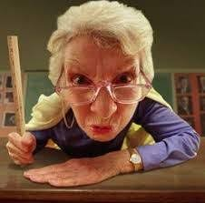
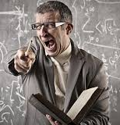

Why Are There Bad Teachers?
Opportunity cost! The best and brightest usually do something else!

Slide 36
Tradeoffs Are Everywhere!

Slide 37


Slide 38

FDA safety regulations keep new drugs and medications from reaching the market.
This can potentially lead to more deaths.

Slide 39
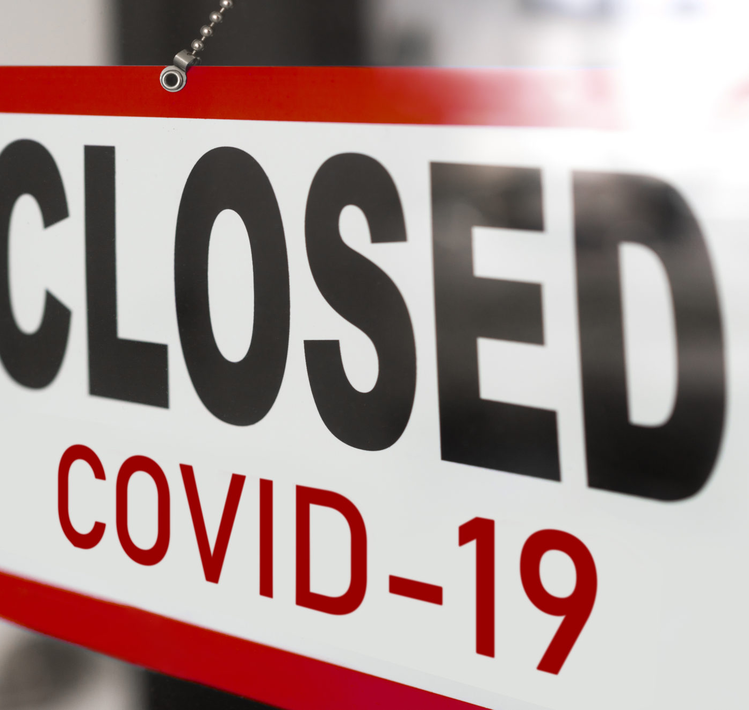
Covid Lockdowns?
Lockdowns may prevent deaths from covid.
But they may lead to deaths from other causes:
Depression/Anxiety
Addiction
Domestic Abuse
Diseases due to the inability to receive routine medical screenings.

Slide 40
Tradeoffs
Tradeoffs exist because of scarcity.
Choices involve sacrifice. Doing one thing means doing less of something else.
But we don’t always make the same choices…..
Notes:
A good application of the UNSEEN.

Slide 41
People Respond to Incentives
Notes:
The basic postulate in economics!
Rewards and penalties that motivate behavior.
Individuals respond to the costs and benefits of their actions. When the costs and benefits change, their actions will change.
If the benefit of doing something increases, people will do more of it.
If the cost of doing something increases, people will do less of it.
If the price of a good rises, consumers will want to buy less of it and producers will want to make more of it.
Incentives are not just prices. Oftentimes new laws or rules create incentives that lead to numerous unintended consequences…

Slide 42


Slide 43
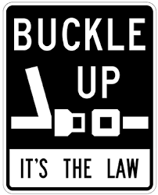
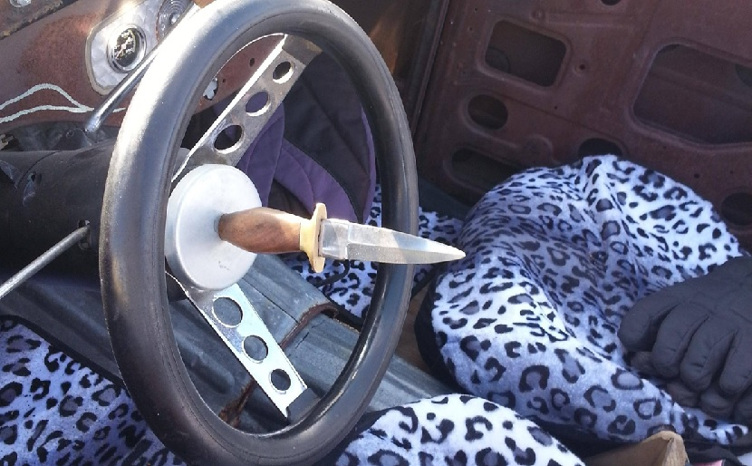
Seatbelt Laws

Slide 44
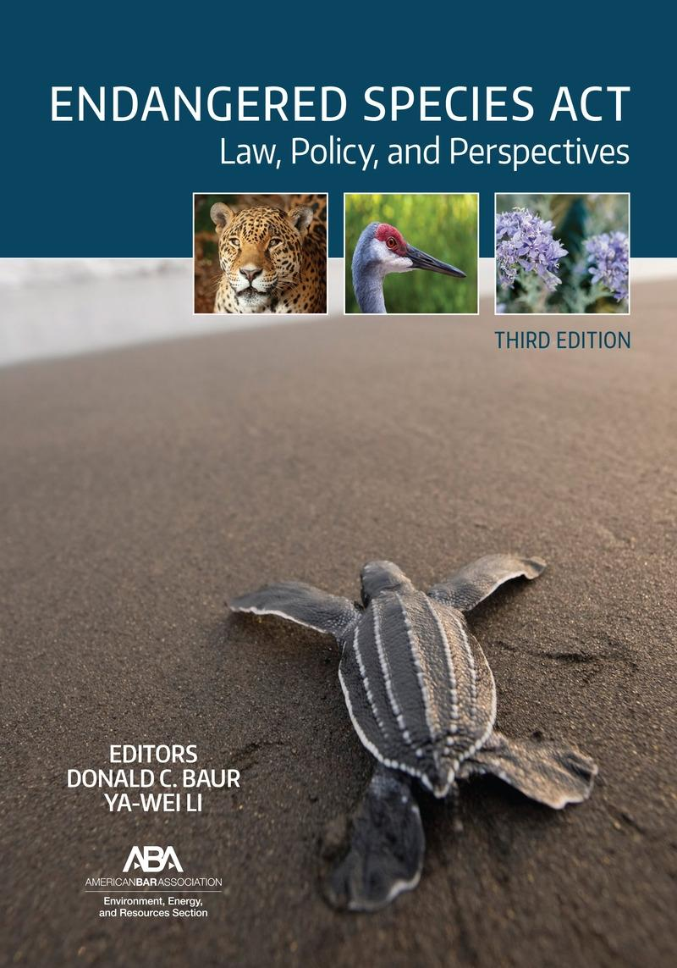

Slide 45
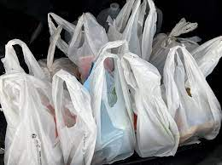
Plastic Bag Laws

Slide 46
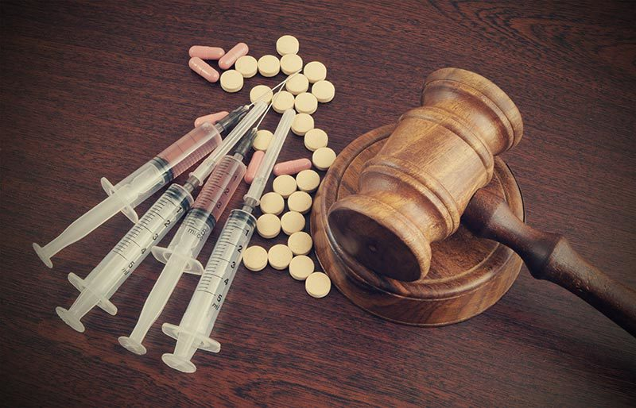



Slide 47
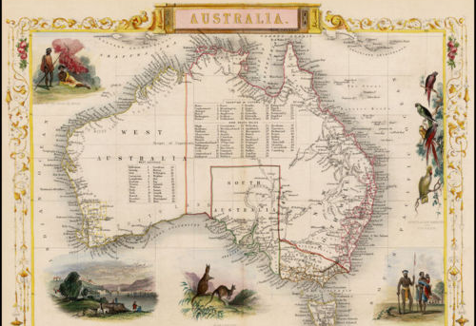
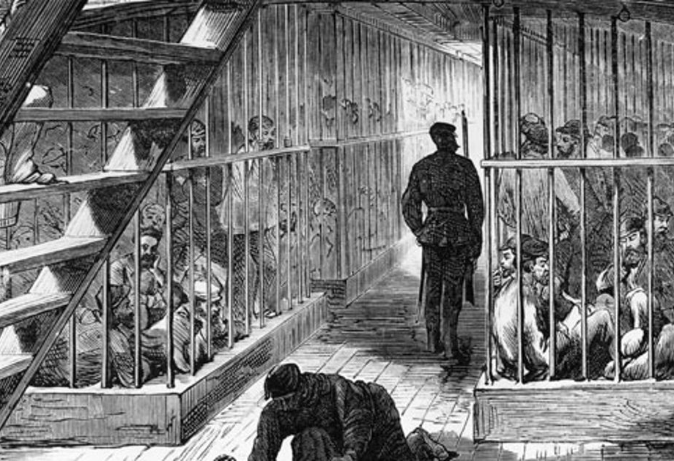
Australian Penal Colonies 1790s
Notes:
Between 1790 and 1792, 12% of the convicts died, to the dismay of many good-hearted English men and women who thought that banishment to Australia shouldn’t be a death sentence. On one ship 37% perished.
The government decided to pay the captains a bonus for each convict that walked off the boat in Australia alive.
This simple change worked like a charm. Mortality fell to virtually zero. In 1793, on the first three boats making the trip to Australia under the new set of incentives, a single convict died out of 322 transported, an amazing improvement. I don’t think the captains got any more compassionate. They were just as greedy and mean-spirited as before. But under the new regulations, they had an incentive to act as if they were compassionate. The change in incentives aligned the self-interest of the captains with the self-interest of the convicts. Convicts were suddenly more valuable alive than dead. The captains responded to the incentives.

Slide 48
Be Cautious of Secondary Effects

Slide 49
Institutions Matter!
Notes:
The “rules of the game,” humanly devised constraints, that govern our social interaction. that govern our social interaction. Can shape our incentives for better or worse.
Formal and/or informal. Examples?

Slide 50
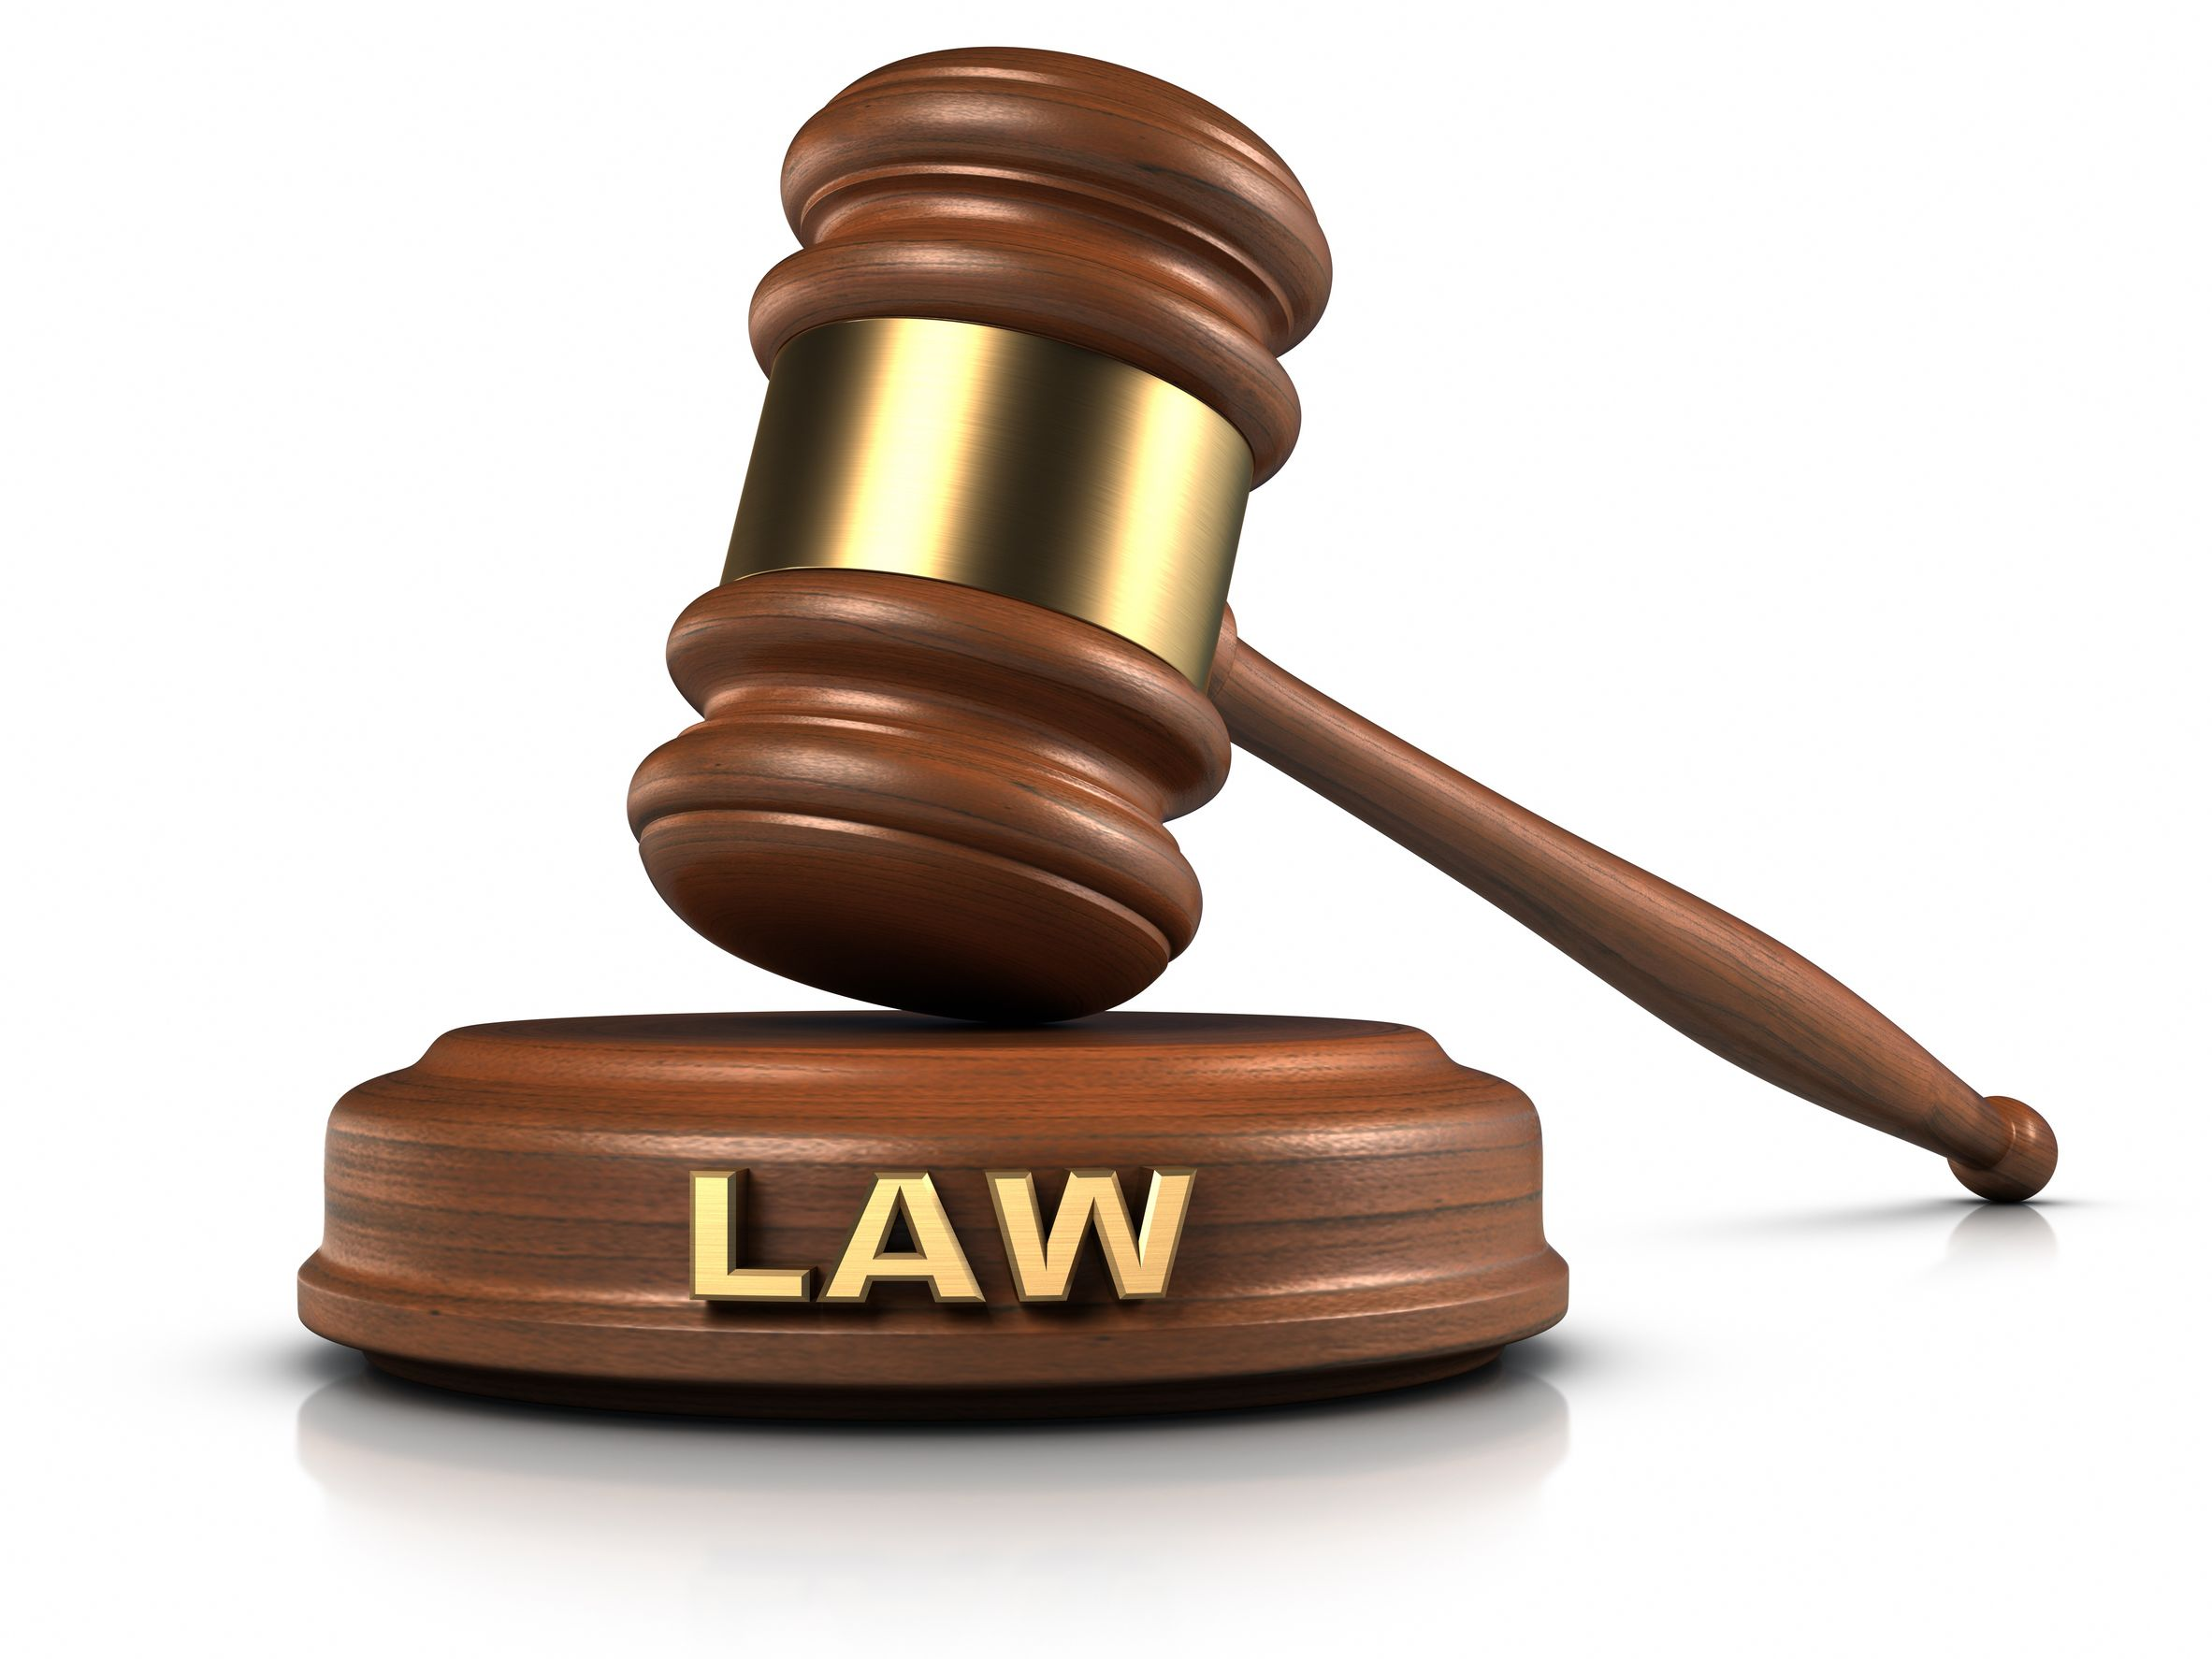
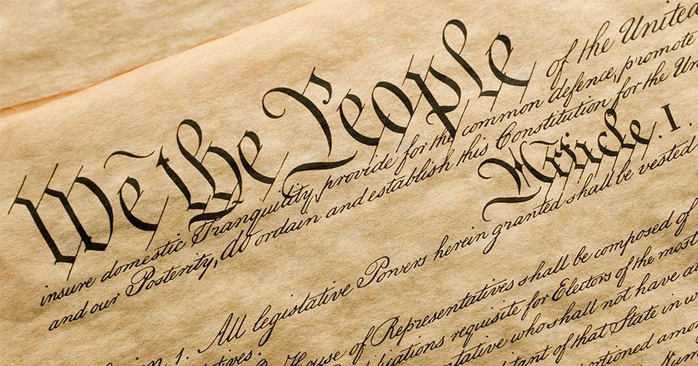

Slide 51


Slide 52
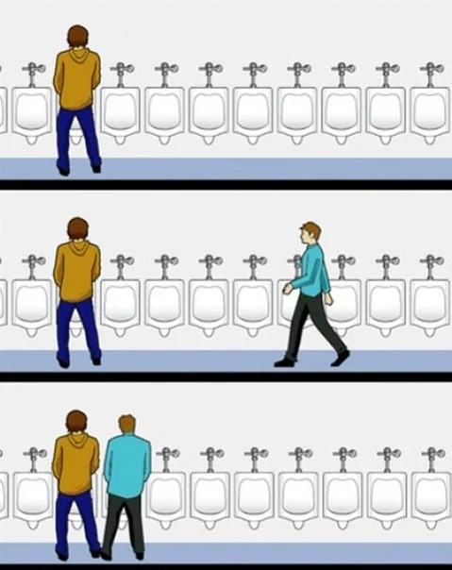


Slide 53

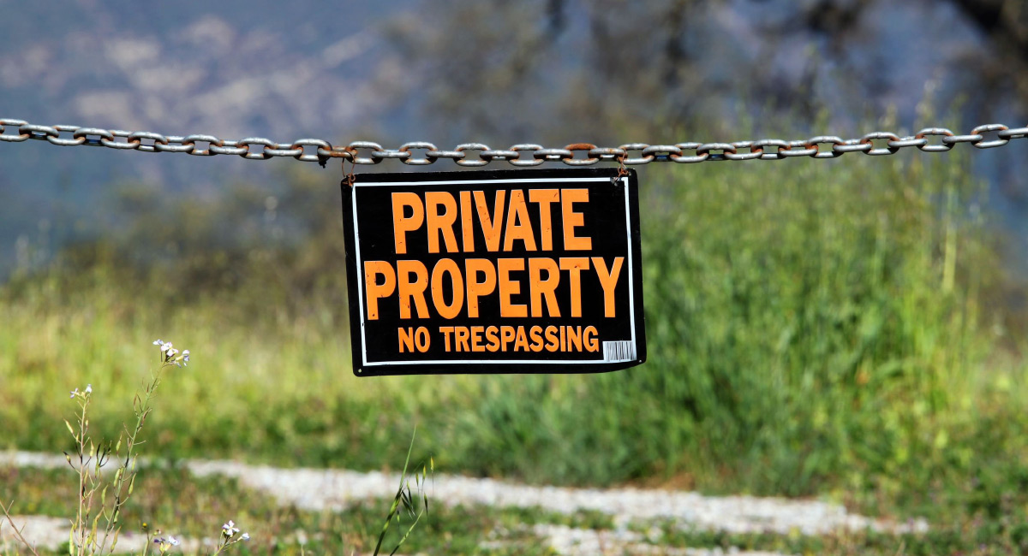
Notes:
Property Rights
The ability of individuals to own and control their own scarce resources.
Can be both formal and informal.
Governments (formal institutions) can sometimes protect property rights.
Protecting property rights incentivizes productive, profit-seeking behavior that reverberates throughout the economy.
Property rights incentivizes productive, profit-seeking behavior that reverberates throughout the economy.
Institutions greatly incentivize our behavior for better or for worse.

Slide 54
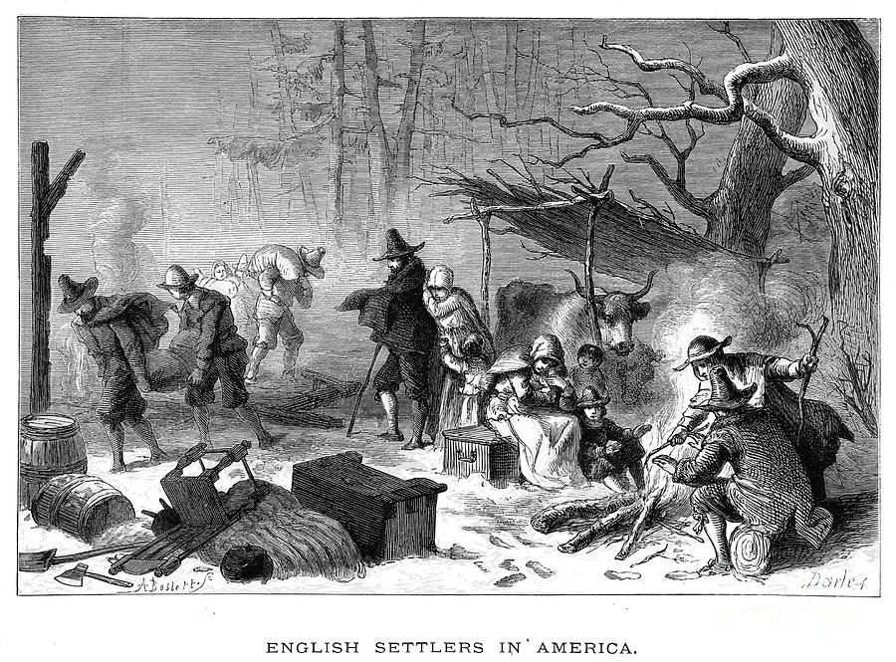
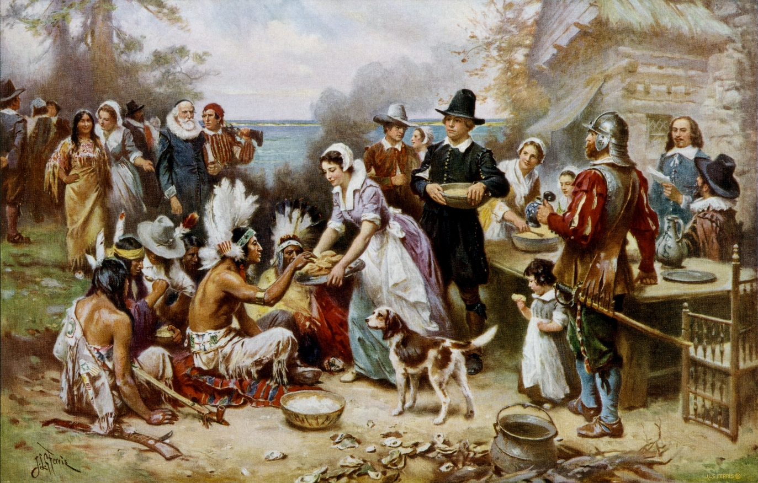
Notes:
Many people believe that after suffering through a severe winter, the Pilgrims’ food shortages were resolved the following spring when the Native Americans taught them to plant corn and a Thanksgiving celebration resulted. In fact, the pilgrims continued to face chronic food shortages for three years until the harvest of 1623. Bad weather or lack of farming knowledge did not cause the pilgrims’ shortages. Bad economic incentives did.
In 1620 Plymouth Plantation was founded with a system of communal property rights. Food and supplies were held in common and then distributed based on “equality” and “need” as determined by Plantation officials. People received the same rations whether or not they contributed to producing the food, and residents were forbidden from producing their own food. Governor William Bradford, in his 1647 history, Of Plymouth Plantation, wrote that this system “was found to breed much confusion and discontent and retard much employment that would have been to their benefit and comfort.” The problem was that “young men, that were most able and fit for labour, did repine that they should spend their time and strength to work for other men’s wives and children without any recompense.” Because of the poor incentives, little food was produced.
Faced with potential starvation in the spring of 1623, the colony decided to implement a new economic system. Every family was assigned a private parcel of land. They could then keep all they grew for themselves, but now they alone were responsible for feeding themselves. While not a complete private property system, the move away from communal ownership had dramatic results.

Slide 55
SO WHAT?!

Slide 56
Scarcity Necessitates Rationing
Every society must have a means to ration scarce resources among competitive uses.
No matter what, we face tradeoffs and act on the margin.
How can we ration?

Slide 57
Markets Do It Best!

Slide 58
Markets
Decentralized institutions where individuals voluntarily exchange their goods and services via the price system.
Under government or collective organizations, rationing is done via other means (lobbying, regulation, favor seeking, power seeking).
Productive, unproductive, or destructive?

Slide 59
Markets
Changing the method of rationing will change the form of competition.
It will not eliminate competitive tactics.

Slide 60
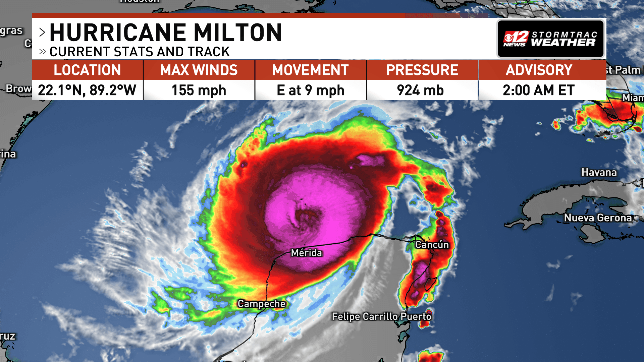
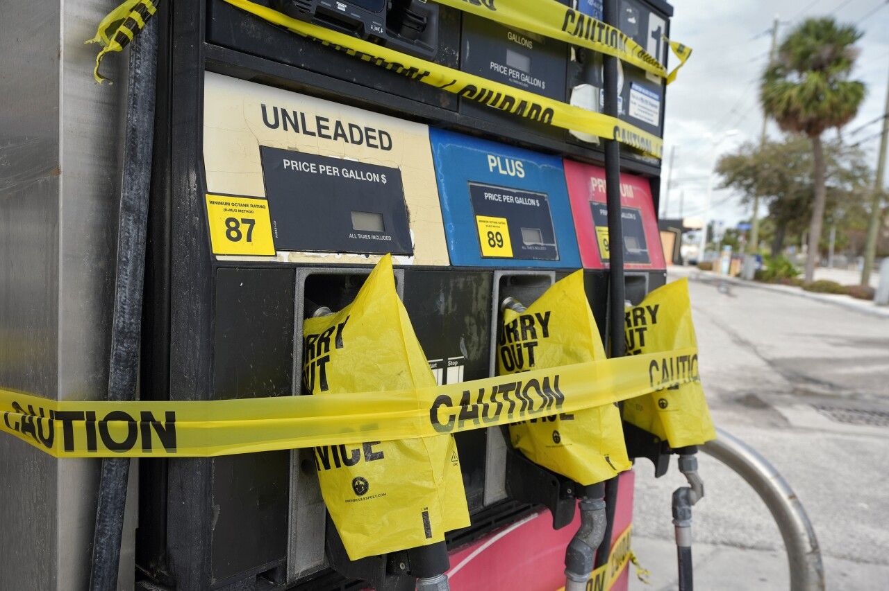
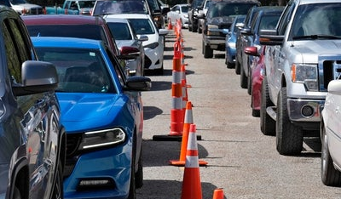
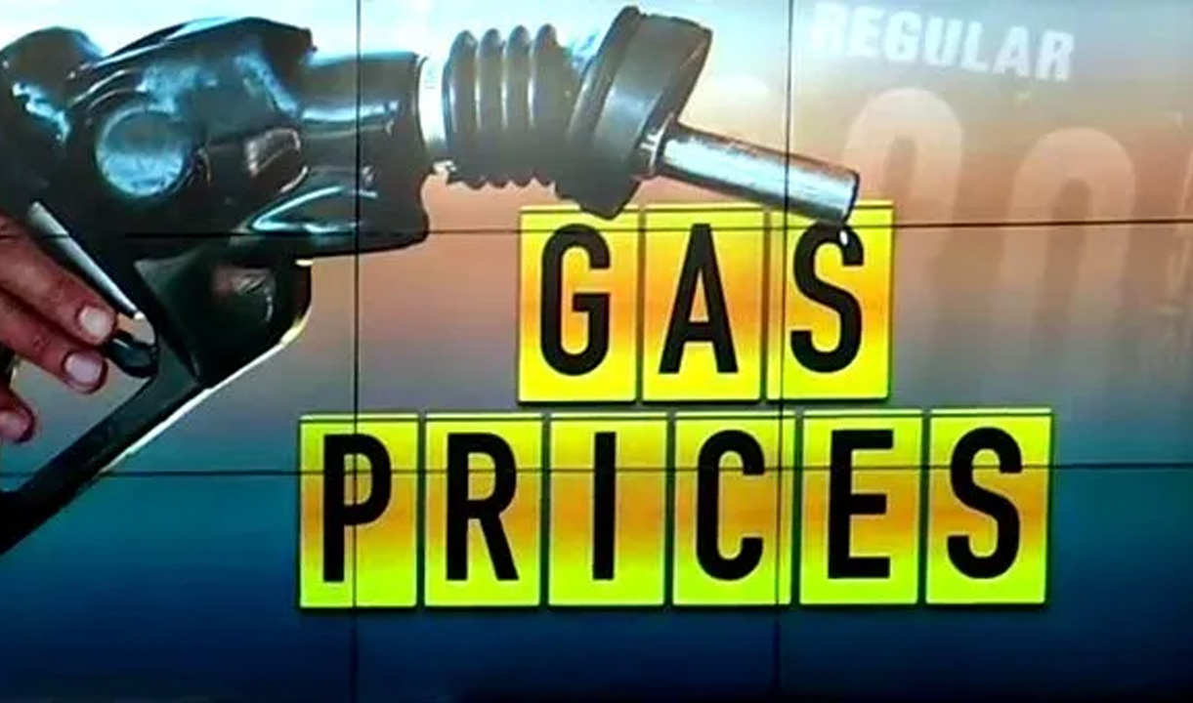

Slide 61
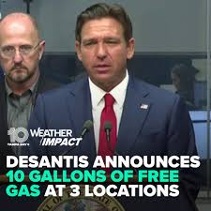

Slide 62
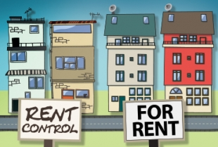
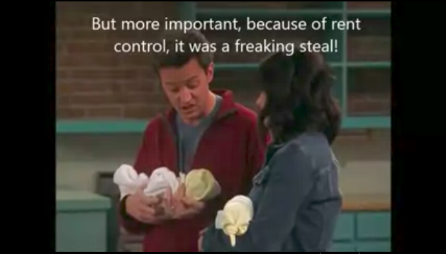

Slide 63


Slide 64
The Economic Way of Thinking

Slide 65

Thank Ye’
Lads & Lassies!

